Slide 1

DS 280 – SPRING 2019 Big Data Architecture Final Project
Wes McNall

Slide 2

Crime in KCMO
What insights can we gain from a dataset on crime in KCMO?
How has crime changed overtime in KCMO?
When are crimes reported?
What's the age of those involved in crime?
Where in KCMO has the most crime?

Slide 3
Dataset Details
File Type: .csv
File Size: 138 MB
Data Source: https://data.kcmo.org
SQL Script Name: crime.hql
Anything interesting about dataset?
A combination of five datasets all from the same website, from 2014-2018 Crime in KCMO.
Did some minor editing in Python to combine them cleanly
Interesting columns:
Description of the crime
Zip code of the crime
When the crime was reported
An estimation of when the crime could have happened
If a firearm was used in the crime

Slide 4
DB & Table Details
Database Name: crime_db
Table Name: crime_tbl_partition
Table Type: External

Slide 5
DB & Table Details
Field Names:
Address
Age
Area
Beat
City
DV_Flag
Description
Firearm_Used_Flag
From_Date
IBRS
Invl_No
Involvement
Latitude
Longitude
Offense
Race
Rep_Dist
Report_No
Reported_Date
Sex
To_Date
Zip_Code
Year

Slide 6
DB & Table Details
Anything interesting about the table?
Before partitioning the data, my SQL queries were taking 300+ seconds to complete.
After partitioning by year, those went down to ~20 seconds to complete.

Slide 7


Slide 8
Data Discovery - Query 1
How are the number of crimes broken down by Zip Code? How has the number of crimes within these areas changed year by year?
set hive.groupby.orderby.position.alias = true;
SELECT Year, INITCAP(City), Zip_Code, description, ibrs, COUNT(Firearm_Used_Flag)
FROM crime_tbl_partition
GROUP BY 3, 1, 2, 4, 5;

Slide 9
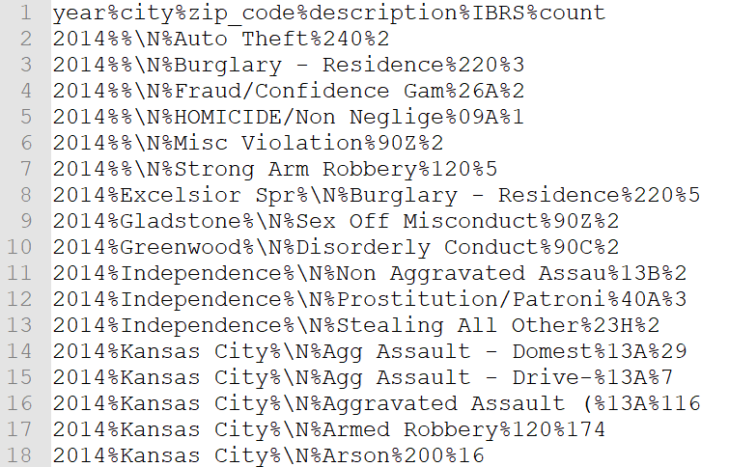
Data Discovery - Query 1

Slide 10
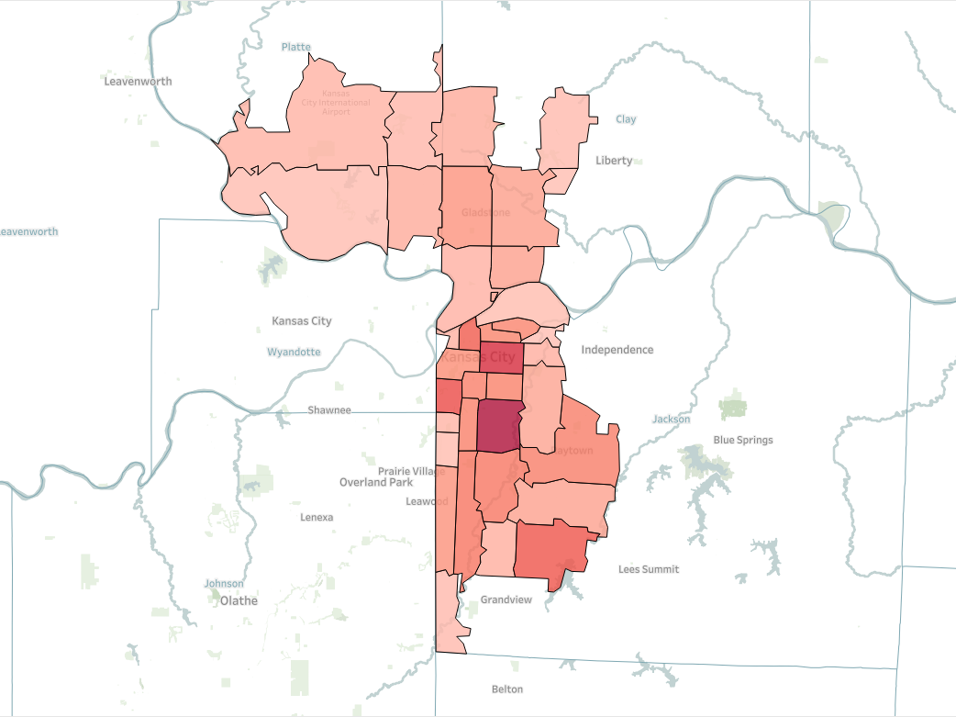
Zip Code: 64130
Crime Count: 39,863

Slide 11
Data Discovery - Query 2
What crimes have happened since I moved to Kansas City?
SELECT reported_Date, ibrs, description, INITCAP(CASE WHEN DV_Flag = 'Y' THEN 'Yes' WHEN DV_FLAG = 'N' THEN 'NO' ELSE 'UNKOWN' END), Firearm_Used_Flag, Involvement, Age, Location, Zip_Code
FROM crime_tbl_partition
WHERE reported_date > '2017-07-01 00:00:00';

Slide 12
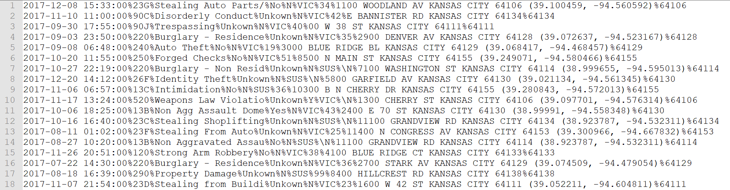
Data Discovery - Query 2

Slide 13
Data Discovery - Query 3
How has crime changed on a month level?
Are there any seasonal patterns to it?
SELECT Year, MONTH(reported_date), COUNT(Firearm_Used_Flag)
FROM crime_tbl_partition
GROUP BY 1, 2;

Slide 14
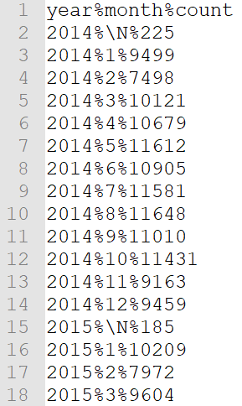
Data Discovery - Query 3
It turns out there isn’t much seasonality related to crime. The time of year doesn’t really affect the number of crimes that do happen

Slide 15
Data Discovery - Query 4
What crimes are committed by what age person?
What age are the victims of crimes?
ROUND(PERCENTILE(CAST(Age AS BIGINT), 0.5), 0)
FROM crime_tbl_partition
WHERE age > 0 AND age < 100
GROUP BY involvement, sex, ibrs, description;

Slide 16
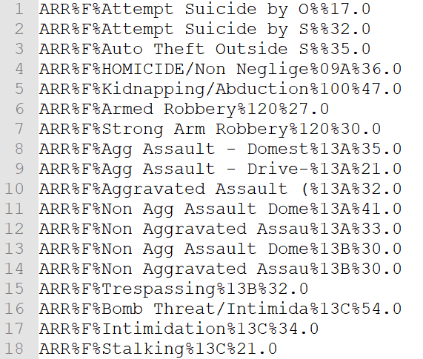
Data Discovery - Query 4

Slide 17
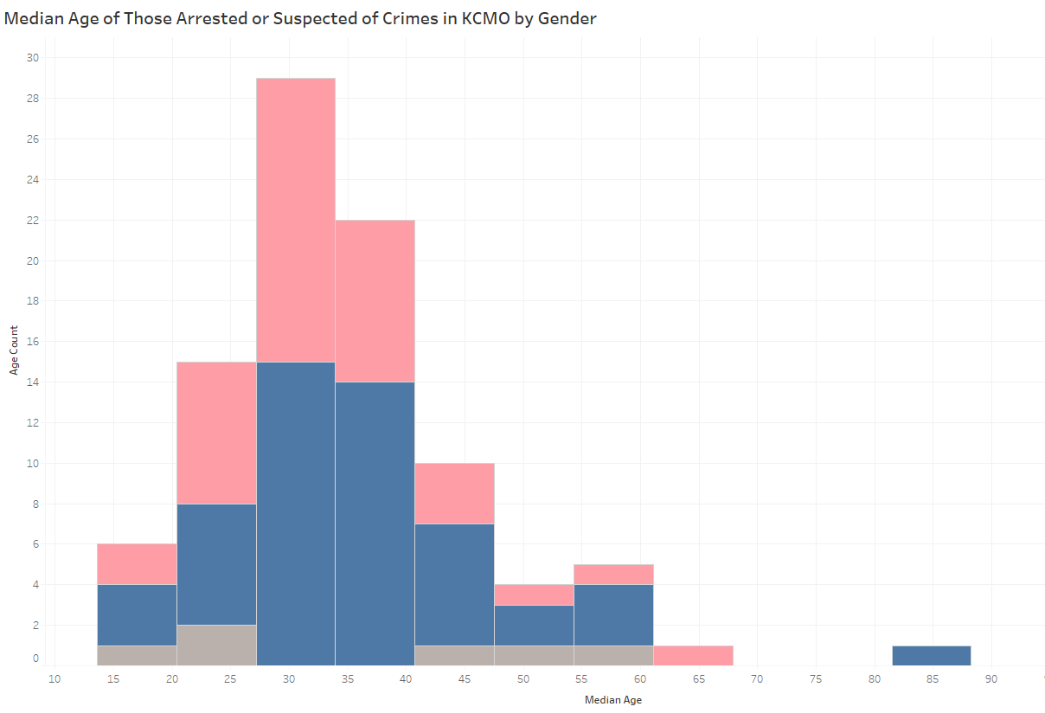

Slide 18
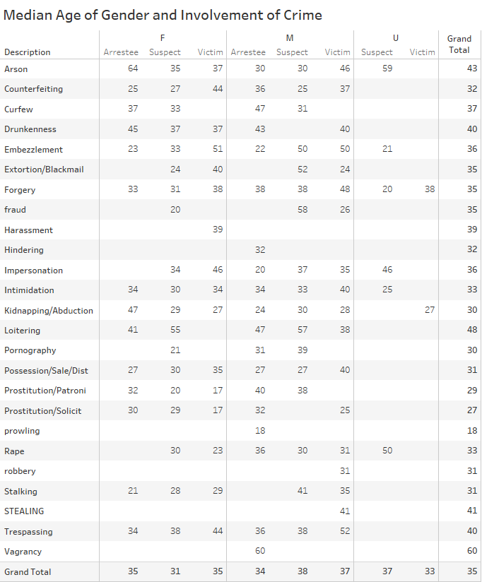

Slide 19
Data Discovery - Query 5
How have the crimes involving firearms changed over the years?
SELECT Year, firearm_crime, crime_count, ROUND(firearm_crime / crime_count, 3) AS firearm_prop
FROM (
SELECT Year, SUM( CASE WHEN Firearm_Used_Flag = 'Y' THEN 1 ELSE 0 END ) AS firearm_crime, COUNT(Zip_Code) AS crime_count
FROM crime_tbl_partition
GROUP BY Year
)
crime_tbl_partition;

Slide 20
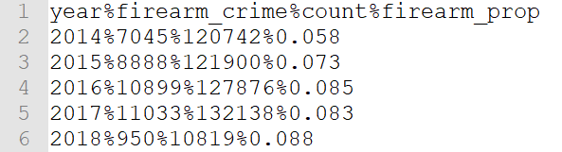
Data Discovery - Query 5

Slide 21
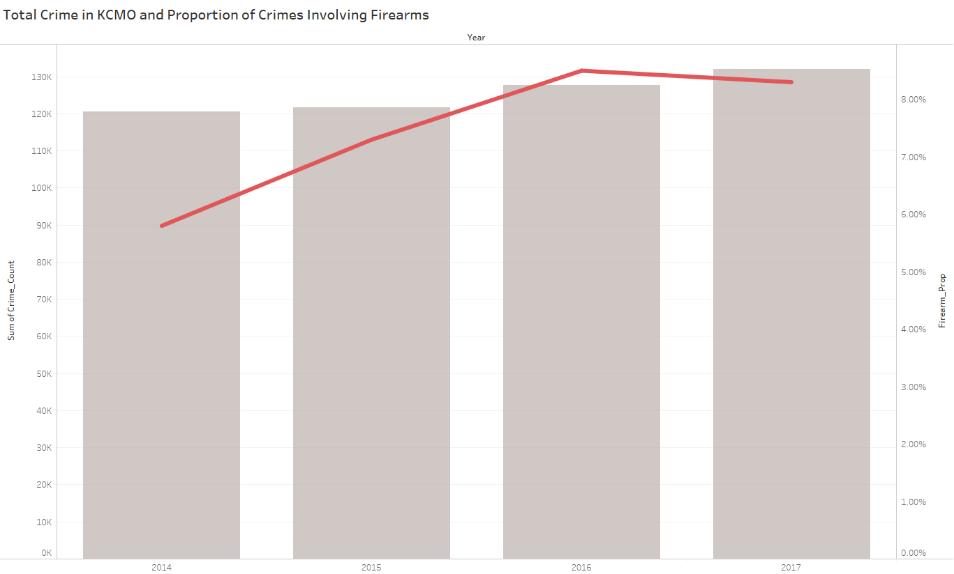

Slide 22
Data Discovery - Query 6
What hour of the day are crimes reported?
SELECT Year, MONTH(reported_date) as month, HOUR(reported_date) as hour, SUM( CASE WHEN Zip_Code = -1 THEN 0 ELSE 1 END )
FROM crime_tbl_partition
GROUP BY 1, 2, 3;

Slide 23
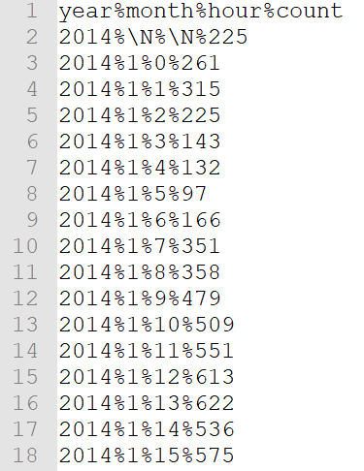
Data Discovery - Query 6

Slide 24
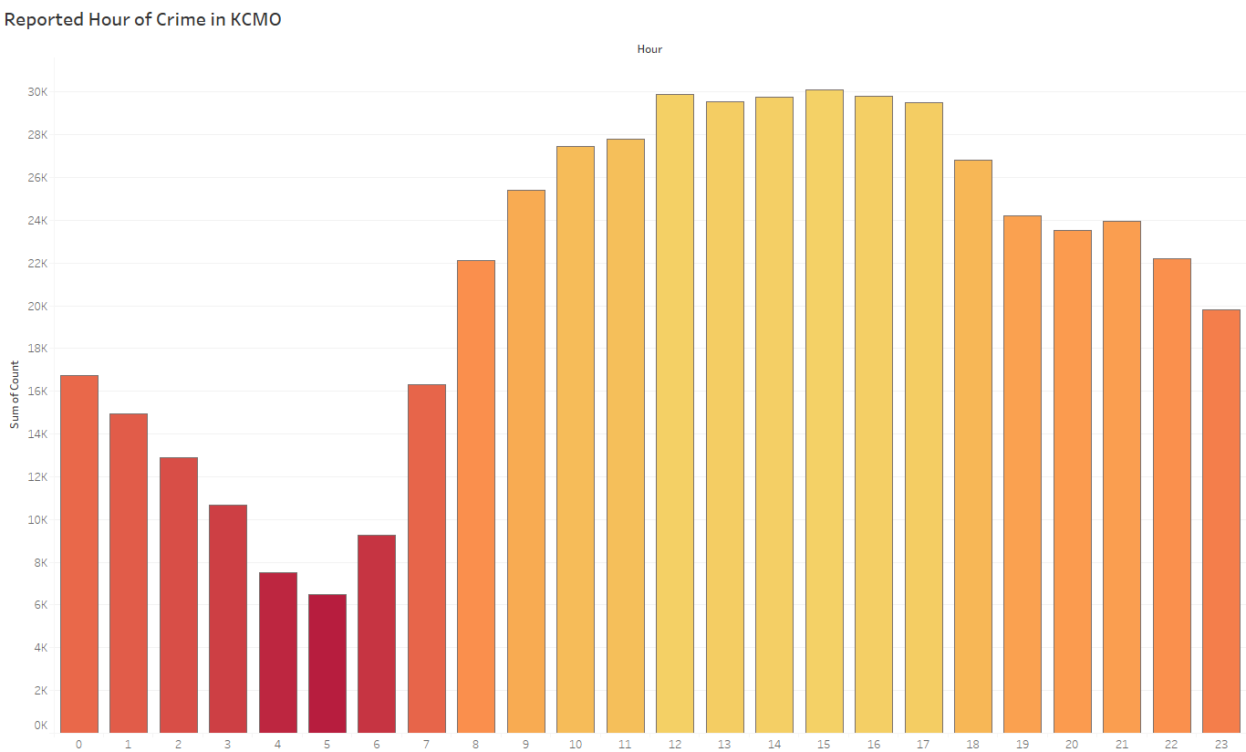

Slide 25
Business Problem
By doing this analysis I feel like I have a better understanding of some of the aspects of crime within KCMO
I feel like if there are any other interesting questions about the dataset I’d be able to figure out how to write SQL queries to get those answers and be able to visualize them
My clients can conclude that older suspects tend to skew male
Knowing where the majority of crime happens allows my clients to be able to staff appropriately. Along with knowing what hour of the day most crimes are reported.
The client can conclude that the 64130 zip code needs the most attention and that the majority of crimes are reported from 12-5pm so to have the most amount of staff on hand during those times

Slide 26

Business Problem

